Slide 1

Distributed Databases
7 May 2026
Lynette Barnard

Slide 2

Our Focus
Distributed database management systems (DDBMS)
Data storage and processing take place over networks
Both data and processing distributed (different sites)
Multi-site database forms core of distributed database system
Image by rawpixel.com on Magnific
Image by DC Studio on Freepik

Slide 3
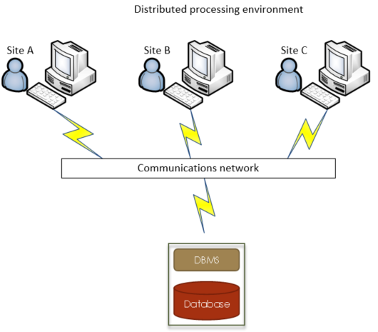
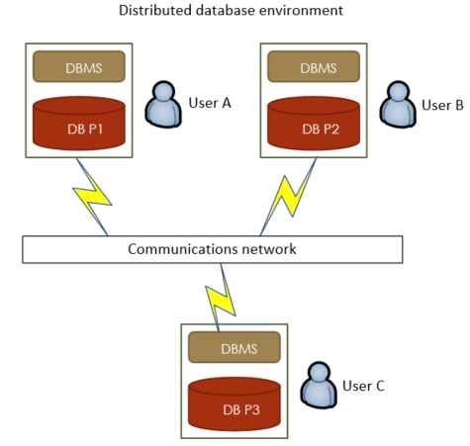
Distributed processing and distributed database
Distributed processing does not require distributed database
Distributed database does require distributed processing

Slide 4
DDBMS Characteristics
Fully distributed - perform all functions of centralised DBMS, e.g.
Receive user request
Validate, analyse, decompose request
Locate requested data (wherever located)
Ensure database consistency, security, integrity
Present requested data in required format
Data and processing distribution should be transparent to user
Chapter 14 - Distributed Databases

Slide 5
Components of DDBMS (Fig 14.5, p 718)
Computer workstation / remote device
Network hardware & software
Communications media
Transaction or Application processor (TP or AP) / Transaction manager (TM)
Software component that requests data
Receives and processes remote and local data requests
Data processor or manager (DP or DM)
Software component that stores / retrieves data at local site
Communication between TP and DP handled via protocols

Slide 6
Distributed database transparency features
Hide system complexities so user perceives database as single-user
Transparency features
Distribution (user unaware of partitioning, replication, location)
Transaction (data updated at multiple sites; integrity & consistency ensured)
Failure (system continues if one node fails)
Performance (performs as if centralised)
Heterogeneity (integrate different local DBMSs)

Slide 7
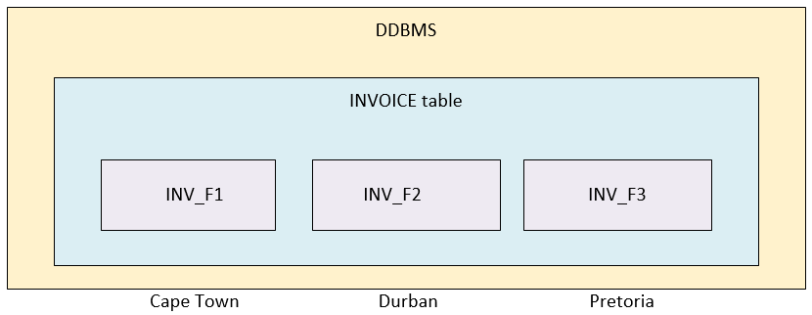
Distribution transparency
Fragment
Location
Physically dispersed database managed as if centralised
Three distribution transparency levels
Local mapping
Location
Fragmentation
If SQL requires…
Fragment name e.g. INV_F2 | Location name e.g. Durban | Then DBMS supports | Level of distribution transparency
Yes | Yes | Local mapping | Low
Yes | No | Location transparency | Medium
No | No | Fragmentation transparency | High

Slide 8
Transaction transparency
Transactions to maintain distributed database integrity and consistency
Transactions can update data stored in many different computers via network
Transactions only completed once all sites involved in transaction completed their parts
Complex mechanisms to manage transactions
Need to understand basic concepts
Remote & distributed requests
Remote & distributed transactions

Slide 9
Transaction transparency
Requests and Transactions
Remote request (Figure 14.10 p 726)
Single SQL statement accesses data at single site
Remote transaction (Figure 14.11 p 727)
Composed of several requests
Accesses data at a single site
Distributed transaction (Figure 14.12 p 728)
Transaction (several requests) references several local or remote sites
Each request accesses only one site at a time
Distributed request (Figure 14.13 and 14.14 p 729)
Single SQL statement references data located at several local or remote sites

Slide 10
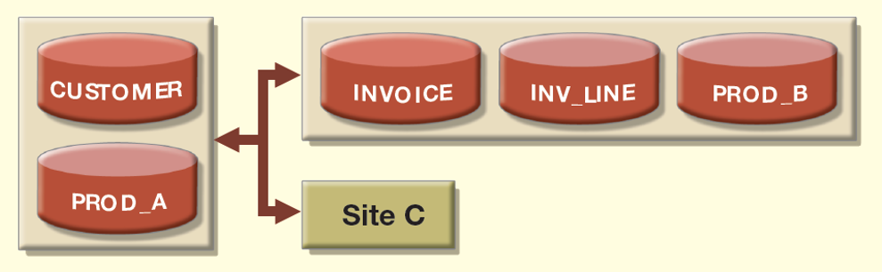
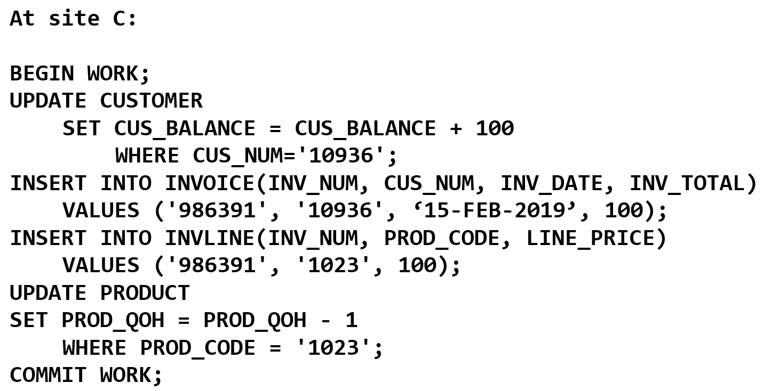
Examples
Requests and transactions
UPDATE CUSTOMER
Remote request
INSERT INTO INVOICE
Remote request
INSERT INTO INVLINE
Remote request
UPDATE PRODUCT
Distributed request
Entire transaction at site C
Distributed transaction

Slide 11
Performance transparency
Allows DDBMS to perform as if centralised
Issues related to data requests in distributed data environment
Data distribution (which fragment?)
Data replication (all replicas to remain consistent)

Slide 12
Distributed database design
Data fragmentation
Break single object into multiple segments / fragments
Data replication
Which fragments to replicate
Data allocation
Where to locate fragments and replicas

Slide 13
Data fragmentation
Object (user database / system database / table) split into more than one fragment
Each fragment can be stored at any site over network
Information stored in distributed data catalogue
Accessed by TP to process user requests
Fragmentation strategies
Horizontal (Fig 14.17, p 735)
Vertical (Fig 14.18, p 736)
Mixed (Fig 14.19, p 737)

Slide 14
Data fragmentation: Horizontal
Divides relation into fragments of rows
All rows must have same (number of) attributes
Similar to SELECT with WHERE clause on single attribute
If equal distribution of rows required among fragments
Use round-robin partitioning
Range partitioning based on partition key

Slide 15
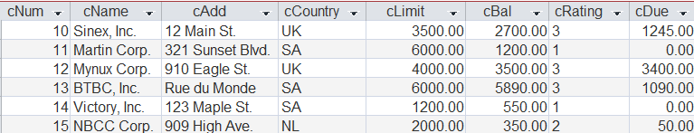
Data fragmentation: Horizontal
Fragment per country (horizontally)
Partition key will be cCountry

Slide 16

Data fragmentation: Horizontal
Partition key cCountry

Slide 17
Data fragmentation: Vertical
Divides relation into subsets based on specific attributes
Each subset has unique columns, except for key column
Key column common to all fragments
Each vertical fragment must have same number of rows
Similar to PROJECT statement in SQL

Slide 18
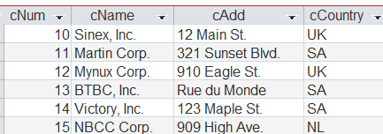
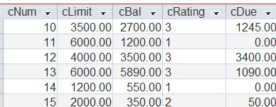
Data fragmentation: Vertical
Split Address info from Financial info (key column common to both)

Slide 19
Data fragmentation: Mixed
Two steps
Horizontal fragmentation to extract relevant rows
Vertical fragmentation (per horizontally fragmented subset) to extract columns

Slide 20






Data fragmentation: Mixed
Split Address info from Financial info, per country, e.g. (key column common to all)

Slide 21
Data replication
Storage of data copies at multiple sites served by computer network
Serves specific information requirements
Improve data availability and response time
Reduce communication and total query costs
Mutual consistency rule
ALL copies of data fragments must be identical

Slide 22
Replication types
Fully
Stores multiple copies of each database fragment at multiple sites
Partially
Stores multiple copies of some fragments at multiple sites
Un-replicated
Stores each database fragment at single site
Potentially impractical due to overhead
No duplicate database fragments

Slide 23
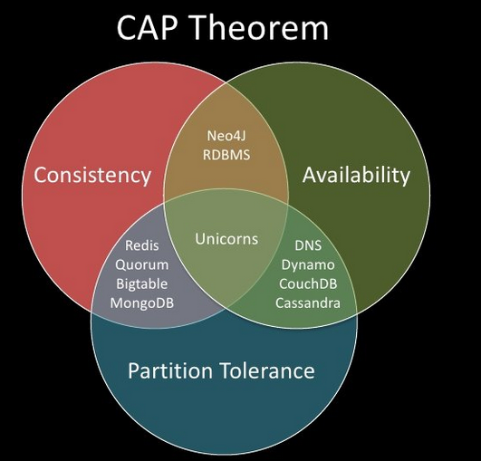
CAP Theorem
Refers to desirable properties in highly distributed systems
Consistency
Availability
Partition tolerance
Nikolaidis, Fotis. (2019). Tromos : a software development kit for virtual storage systems.

Slide 24
BASE
Some companies forfeit consistency and isolation
Aim to achieve higher availability and flexibility
New type of distributed system - BASE
BAsically available, Soft state, Eventually consistent (consistency vs. availability)
Data consistency model
Data changes not immediately updated
Propagate slowly through the system
All replicas will (eventually) be consistent

Slide 25
DDBMS in the cloud
3rd party supplies IT services
Offers interconnected & virtual computers
Pricing often negotiated
Arrangement typically via service level agreement (SLA)
Cost effective for client
Latest software
Scalable architecture
Anywhere, anytime access
Traditional DDBMS not compatible with cloud services
Cloud solutions allocate resources dynamically, based on requirements
Potential solution – NoSQL database

Slide 26
CJ Date’s (1987) 12 commandments for distributed databases
Local site independence
Central site independence
Failure independence
Location transparency
Fragmentation transparency
Replication transparency
Distributed query processing
Distributed transaction processing
Hardware independence
Operating system independence
Network independence
Database independence

Slide 27
Portfolios
If you haven’t started compiling yet – good time to start now
Use Portfolio details in Assignment and Portfolio Guide as a checklist
ALL information contained there
Format
Content
All other requirements
Marking rubric
Rubrics to be included
Final academic progress email will contain rubrics to be included
Also include Portfolio rubric (the one at the end of the Assignment and Portfolio Guide)

Slide 28

Semester test 2 – Final notice
Schedule:
Tuesday, 12 May
May bring in ONE page (double sided) hand written (no photocopies) notes
2-hour test, 60 marks
Booking list available just before test sessions (outside labs)
Seat and PC allocation – ensure you know your allocated seat

